Slide 1


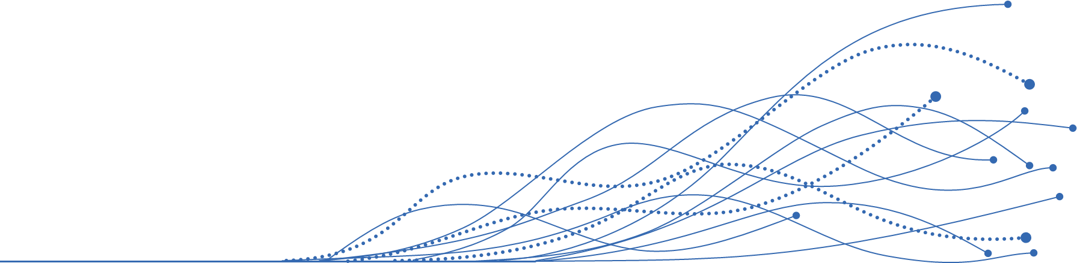


AGENTIC
Agentic AI in: Life Sciences
Designing and Building Agentic AI Teams for Life Sciences Demo: Automated Identification, Synthesis, & Reporting of Medical Insights
Q4 – 2025
Acquis Consulting. Private & Confidential

Slide 2
Aligning on possible discussion topics today
I
Introductions – a bit about Acquis
II
Level-setting – maturity of agentic AI teams in Life Sciences today
V
IV
III
Demo – art of the possible: agentic AI teams in Life Sciences
Other topics of interest?
What agentic teams do you want us to build for you?
AGENTIC
Notes:
Intros – 10 minutes
Level Setting – 15 minutes
Demo – 15 minutes
Discussion – 20 minutes

Slide 3


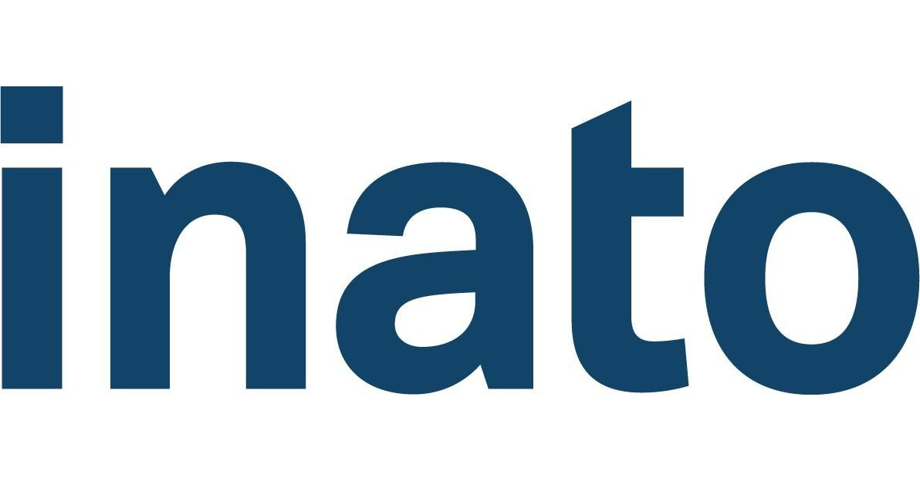
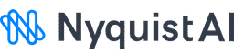



ACQUIS IS A DIFFERENT KIND OF CONSULTANCY THAT BRIDGES MULTI-DOMAIN EXPERTISE TO BUILD AI-READY LIFE SCIENCE ORGANIZATIONS
Deep therapeutic expertise across R&D, Medical, and Commercial functions – we understand the science, the patients, and the business drivers behind every decision.
Decades of proven success in shaping life science organizations, aligning strategy with execution, and building scalable operating models in complex operating environments.
1.5K+
9 of 10
30+
25+
#8
175
Engagements across R&D, Medical, and Commercial Functions
Biopharmaceutical companies trust Acquis Consulting
Product launches supported
Year history (est. 1998)
Fortune’s best workplaces in consulting
Experienced Acquis consultants
LIFE SCIENCE EXPERTISE ACROSS R&D x MEDICAL x COMMERCIAL
Extensive Experience Across 10+ Therapeutic Areas
BUSINESS ACUMEN IN BUILDING OPERATING MODELS, FUNCTIONS & COMPANIES
Discover Current State Op Model
Cross-Section & Review Functions
Assess AI & Automation ROI
Build Future State
Operating Model
Oncology
Rare Diseases
Cardiovascular
Dermatology
Endocrinology
Hematology
Immunology
Neurology
Respiratory
Infectious Diseases
AGENTIC
PYRAMID
Select LS-specific AI tech stack and data provider ecosystem
TECHNICAL CAPABILITIES TO BUILD AND INTEGRATE TOOLS, AUTOMATIONS, AND AI SOLUTIONS
We build future proof functions through high ROI automations and agentic workflows
Design, build, and integrate technology solutions + agentic AI workflows that don’t just streamline tasks, but work as dynamic teammates automating core activities inside core LS functions
AGENTIC

Slide 4






The maturity curve of Agentic AI teams in Life Sciences
Where we are today vs. the future of agentic AI teams
Automated Tasks
Autonomous Outcomes
Deterministic & Directive
Where we are today
Cutting edge
Self-organizing & Collaborative
Large Language Models (LLMs) | AI Agents & “Agentic Teams” | Adaptive Agentic “Swarms” | Self-Organizing Adaptive Networks
Description: A type of artificial intelligence model that is trained to understand language, generate language, and reason Examples: Life Science Use-Cases: Wide deployed across many bio-pharma functional areas to assist and accelerate learning, research, drafting (i.e. medical writing, competitive intel, chatbots, summary of documentation) | Description: Agents are systems (often powered by an LLM) that can store context & take actions in the real world. Agentic teams can be “orchestrated” in designed processes called workflow automations Examples: Life Science Use-Cases: Ingesting different data categories for analysis and contextualized 1st & 2nd draft clinical protocols, live monitoring publications for intelligence, medical KPI tracking across multiple domains, ext. omnichannel engagement, etc. | Description: Multiple agents follow a process of goal decomposition, agent specialization, coordination, parallel actions, and emergent self-improvement towards a common and complex goal Examples: OpenAI Swarm, CrewAI, LangGraph, Microsoft AutoGen Use-Cases: Experimental in other industries – likely sandbox pilots in pharma in 2–4 years | Description: Beyond agentic swarms, the future of AI will branch into many exciting paths (i.e. self-optimization, AI marketplaces, human-AI symbiosis, etc.) towards the ability to achieve greater complexity business and scientific outcomes Use Cases: In the cutting edge AI labs, with validated examples of self-organizing / self-designing models in research and development
AGENTIC

Slide 5

The art of the possible of Agentic AI teams in Life Sciences
What we will cover in today’s demo on Medical Insights
Raw Input Data Processes
Orchestrated Agentic Teams
Automated Outcomes
Documentation Reader Agent(s)
Automated Initiation Triggers
Input to Idea Parser Agent
Idea to Insight Evaluator Agent
Insight Categorization Agent
Insight Analysis Agent
Automated .pptx Generator
This agent reads raw data input from centralized (CRM) database to separate distinct ideas out of a single input
This agent evaluates the value of each distinct idea, and whether they qualify as a useful medical insight
This agent tags every insight by pre-set (and customizable) categories that are relevant to the organization’s strategic medical imperatives, for ex:
Market access insights
Competitive intelligence
Clinical practice insights
HCP education gaps
Clin dev insights
This agent counts, correlates tagged insights with original data entry IDs, and analyzes relevant data across themes
CRM CSV Upload
Automated AE Notification Triggers
Centralized Insights Database
API to MSL CRM
Some insights may be flagged as a possible AE based on regulatory and company specific definitions; which can trigger an automated AE notification to interested parties
THE VALUE OF THIS ACQUIS-AGENTIC AI TEAM IN MEDICAL AFFAIRS
Automated sorting of raw (unstructured) data into insights vs. non-insights
Automated categorizing insights (by medical imperatives, KIQs, or topic)
Automated safety / AE notifications for Safety Ops (optional feature)
Automated executive reporting (via PowerPoint or dynamic dashboards)
AI-Generated considerations for next steps, by category
*For the purpose of this demo, Claude Sonnet 4 was used for the underlying LLM model for all agents
AGENTIC

Slide 6
Real Example Output – Agentic AI teams that can read raw input, evaluate ideas, and categorize insights
Input-to-Idea Parser Agent
Happened to see Bichael Muble at the Starbucks outside the congress hall. Note to self, he likes to drink matcha frappuccino with lavendar cold-foam. After catching up a bit, he mentioned that formulary reviews at their institution have been pushed back repeatedly, which is slowing adoption of new therapies. They also observed competitor reps spinning head-to-head trial data in ways that confuse less experienced staff. As we were closing the discussion, he told me a funny story about one of his bald patients experiencing rapid hair regrowth while on epco. The patient joked that that the hair made him look 20 years younger! He wanted to reconvene next quarter to hear about any new findings.
Raw Input
After catching up a bit, he mentioned that formulary reviews at their institution have been pushed back repeatedly, which is slowing adoption of new therapies.
They also observed competitor reps spinning head-to-head trial data in ways that confuse less experienced staff.
Happened to see Bichael Muble at the Starbucks outside the congress hall. Note to self, he likes to drink matcha frappuccino with lavendar cold-foam.
He wanted to reconvene next quarter to hear about any new findings.
As we were closing the discussion, he told me a funny story about one of his bald patients experiencing rapid hair regrowth while on epco. The patient joked that that the hair made him look 20 years younger!
Ideas
Idea-to-Insight Evaluator Agent
Yes
Yes
No
No
Yes
Why? Valuable?
Highlights an access barrier affecting therapy adoption that could inform Medical Affairs engagement strategy.
Reveals competitive misinformation creating educational gaps among clinical staff, actionable for Medical Affairs education initiatives.
Personal beverage preferences are trivial context unrelated to medical insights.
Future meeting logistics without substantive medical or strategic content.
Describes an unexpected beneficial outcome (hair regrowth) in a patient on epcoritamab, meeting AE criteria for any unintended medical occurrence during product use.
Insight Categorization Agent
Access Insights
Competitive Insights + Education Insights
N/A
Is this Insight a possible AE? Rationale?
This statement describes institutional formulary review delays, which is a classic access barrier affecting drug availability and adoption at the health system level.
Primary focus is on competitor promotional activity and misinformation strategies (Competitive), but also identifies educational needs for clinical staff who are being confused by this messaging (Education).
N/A
This describes an unexpected beneficial outcome (hair regrowth) in a patient on epcoritamab, which meets AE criteria for any unintended medical occurrence during product use. It also provides feedback about the company's own product (epco), making it a Product Insight as well.
Why? Category?
AGENTIC

Slide 7
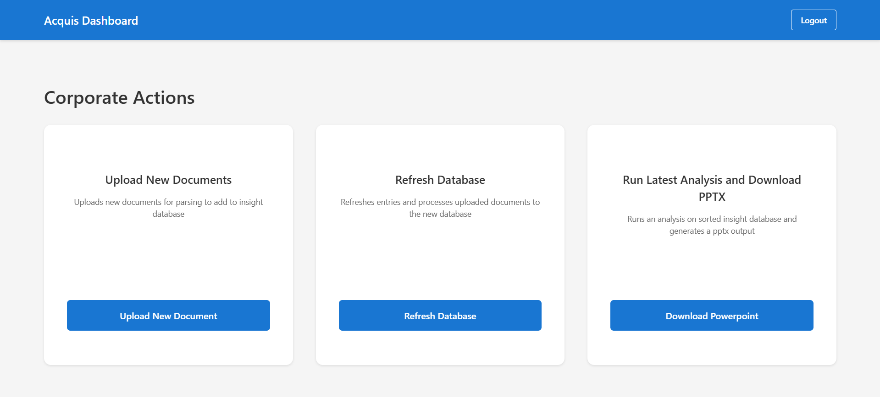
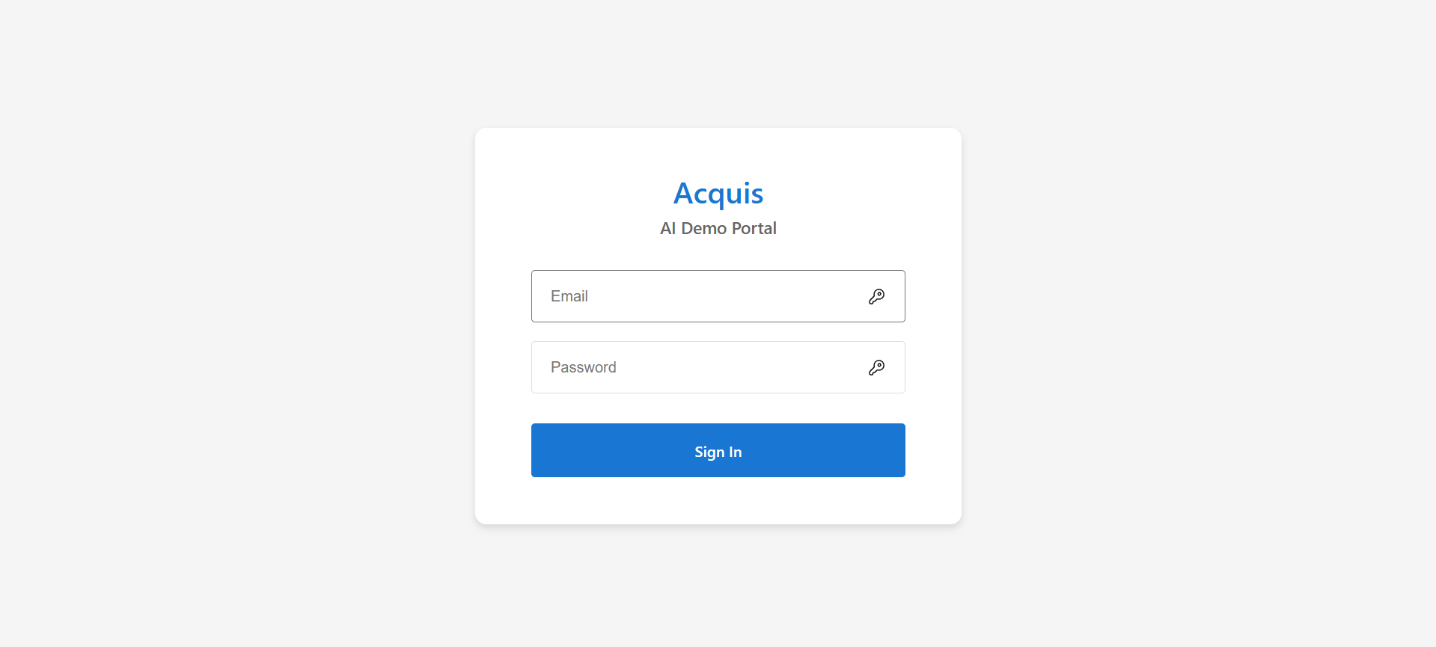
Example Minimalist Front End* – how human teams can interface with agentic teams
Chat with your insights
AGENTIC
In Development*

Slide 8
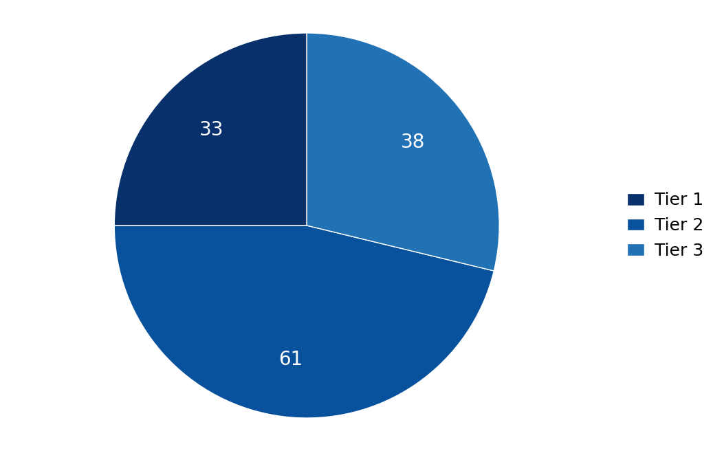
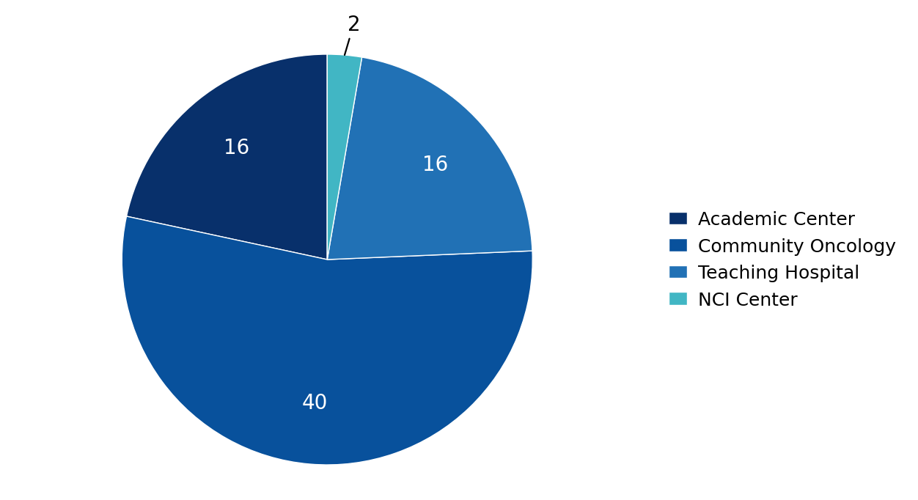
Real Example Output – Automated Executive Dashboard
INSIGHT BREAKDOWN PER KOL TIER
INSIGHT BREAKDOWN BY HCP PRACTICE SETTING
MEDICINE:
Drug X
Drug X is a bispecific antibody developed by Company A and Company B for the treatment of certain B-cell malignancies such as diffuse large B-cell lymphoma (DLBCL).
Date Range of Report
June 2025 - Oct 2025
Total Deployed MSLs
10
Total # HCP Interactions
Total # of Insights Produced
Access Insights
Patient Management / Care Insights
Clinical Development Insights
Total: 74
189
23
39
9
Total # of Non-Insights
Competitive Insights
Product Insights (Drug Science)
Education Insights
Congresses This Quarter
132
ASCO 2025
ASH 2025
EHA 2025
22
11
41
Logistics
Adverse Event (AE) Insights
Other Insights
7
14
2
AGENTIC

Slide 9
Real Example Output –
TOP THREE THEMES FROM PATIENT CARE MANAGEMENT INSIGHTS
Theme 1 (n=10)
Theme 2 (n=7)
Theme 3 (n=7)
Systematic adherence monitoring and support mechanisms are inadequate, leading to frequent treatment discontinuations.
Post-treatment care lacks standardization with poor coordination between oncology and primary care providers.
Primary care physicians delay oncology referrals, resulting in patients starting treatment with limited therapeutic options.
Description
Description
Description
id 38: 'Adherence among younger patients remains a challenge. Patients frequently miss doses because they're juggling work, childcare, or school, and no one systematically follows up until problems arise.'
id 78: 'Adherence monitoring is practically nonexistent once patients leave the hospital. Staff assume patients are compliant, but in reality missed doses are common, especially in younger populations.'
id 62: 'Patients often stop taking oral medications once symptoms improve, only to return with complications later.'
id 70: 'Follow-up care is fragmented, with little communication between oncology and primary care once treatment ends. They argued for a standardized care pathway to ensure patients receive consistent long-term monitoring.'
id 65: 'Survivorship care is handled inconsistently in their hospital, often depending on the initiative of individual providers. They suggested that formal survivorship care templates could improve patient outcomes.'
id 82: 'Survivorship care is inconsistent across departments, with oncology often discharging patients without clear follow-up instructions for primary care.'
id 59: 'Community physicians often wait until multiple treatment failures before referring to oncology, and by then options are limited.'
id 95: 'Primary care physicians often fail to recognize early symptoms, delaying referrals into oncology.'
id 91: 'Community oncologists in their network continue to delay referrals, which often results in patients starting therapy too late.'
Supporting Quotes
Supporting Quotes
Supporting Quotes
1: What systematic adherence monitoring tools can be implemented across different age demographics and care settings?
2: How can proactive follow-up mechanisms be integrated into existing workflow without increasing staff burden?
1: What standardized care transition protocols can ensure seamless handoffs between oncology and primary care?
2: How can survivorship care templates be implemented consistently across different institutional settings?
1: What educational interventions can improve primary care recognition of early symptoms requiring oncology referral?
2: How can referral pathways be streamlined to reduce time from symptom onset to specialist evaluation?
Considerations
Considerations
Considerations
AGENTIC

Slide 10
Real Example Output –
TOP THREE THEMES FROM COMPETITIVE INTELLIGENCE INSIGHTS
Theme 1 (n=9)
Theme 2 (n=9)
Theme 3 (n=5)
Competitors are outpacing our presence through frequent visits, sponsored dinners, symposia, and starter kit distribution.
Competitors are selectively presenting or overstating clinical data to create false impressions of superiority.
Competitor messaging about product convenience, reduced monitoring, and ease of administration is gaining strong traction.
Description
Description
Description
id 43: 'rival teams are "outspending everyone else" with sponsored dinners, symposia, and starter kits'
id 64: 'rival companies are offering well-attended dinners and providing attractive starter kits to clinics'
id 82: 'competitor reps have been visiting their institution more frequently than ours, offering multiple sponsored dinners'
id 39: 'competitor reps are presenting safety data selectively, creating the impression of superiority'
id 52: 'competitor reps are heavily emphasizing safety profiles, sometimes overstating the data'
id 89: 'competitor reps spinning head-to-head trial data in ways that confuse less experienced staff'
id 46: 'competitor's "ease of use" messaging is resonating with nurses'
id 57: 'some of their patients are switching to competitor therapy after hearing claims of reduced monitoring needs'
id 73: 'competitor teams are positioning their new formulation as much easier to use and this messaging is gaining traction'
Supporting Quotes
Supporting Quotes
Supporting Quotes
1: How can we increase our field presence and educational programming to match competitor visibility?
2: What specific incentives or programs can we implement to strengthen relationships with key accounts?
1: How can we proactively educate physicians on proper data interpretation and competitor claims?
2: What tools can we provide to help physicians critically evaluate competing safety and efficacy narratives?
1: How can we better communicate our product's practical advantages and administration benefits?
2: What specific convenience features should we emphasize to counter competitor positioning?
Considerations
Considerations
Considerations
AGENTIC

Slide 11
Real Example Output –
TOP THREE THEMES FROM HCP EDUCATION INSIGHTS
Theme 1 (n=10)
Theme 2 (n=8)
Theme 3 (n=6)
Fellows and residents consistently struggle to interpret clinical trial data, particularly subgroup analyses, endpoints, and statistical measures.
Medical trainees frequently confuse therapeutic mechanisms and lack confidence in making appropriate dose adjustments for complex patients.
Competitive companies are gaining market share through intensive promotional activities that may mislead less experienced physicians.
Description
Description
Description
id 37: 'They explained that fellows in their program often misinterpret subgroup analyses in trial readouts.'
id 50: 'They commented that fellows are still struggling to understand endpoints like PFS versus OS.'
id 63: 'They shared that residents and fellows are still struggling to interpret trial data, particularly hazard ratios and subgroup analyses.'
id 55: 'They said fellows often conflate mechanisms of action across therapies.'
id 69: 'They said younger physicians often hesitate to make dose adjustments in complex patients, preferring to refer cases to senior colleagues.'
id 87: 'They stressed that residents lack confidence in distinguishing mechanisms of action across therapies, creating confusion in teaching environments.'
id 43: 'They said rival teams are 'outspending everyone else' with sponsored dinners, symposia, and starter kits.'
id 64: 'They feel this aggressive outreach is already influencing prescribing decisions, especially among newer physicians who may not be as confident evaluating the data independently.'
id 52: 'They explained that competitor reps are heavily emphasizing safety profiles, sometimes overstating the data.'
Supporting Quotes
Supporting Quotes
Supporting Quotes
1: What specific training methodologies would most effectively improve statistical literacy among medical trainees?
2: How can complex trial data be presented in more digestible formats for busy clinical environments?
1: What comparative educational tools would best help trainees distinguish between different therapeutic mechanisms?
2: How can dose modification training be structured to build confidence in managing complex patient populations?
1: What counter-educational strategies would be most effective against misleading competitive messaging?
2: How can scientific programming be enhanced to provide stronger presence in key markets?
Considerations
Considerations
Considerations
AGENTIC

Slide 12
AGENTIC
What kind of agentic teams would you like us to build for you?
Acquis Consulting. Private & Confidential

